Slide 1


Smart Movies for a Smart Company
Aaron Galbraith • 2023

Slide 2
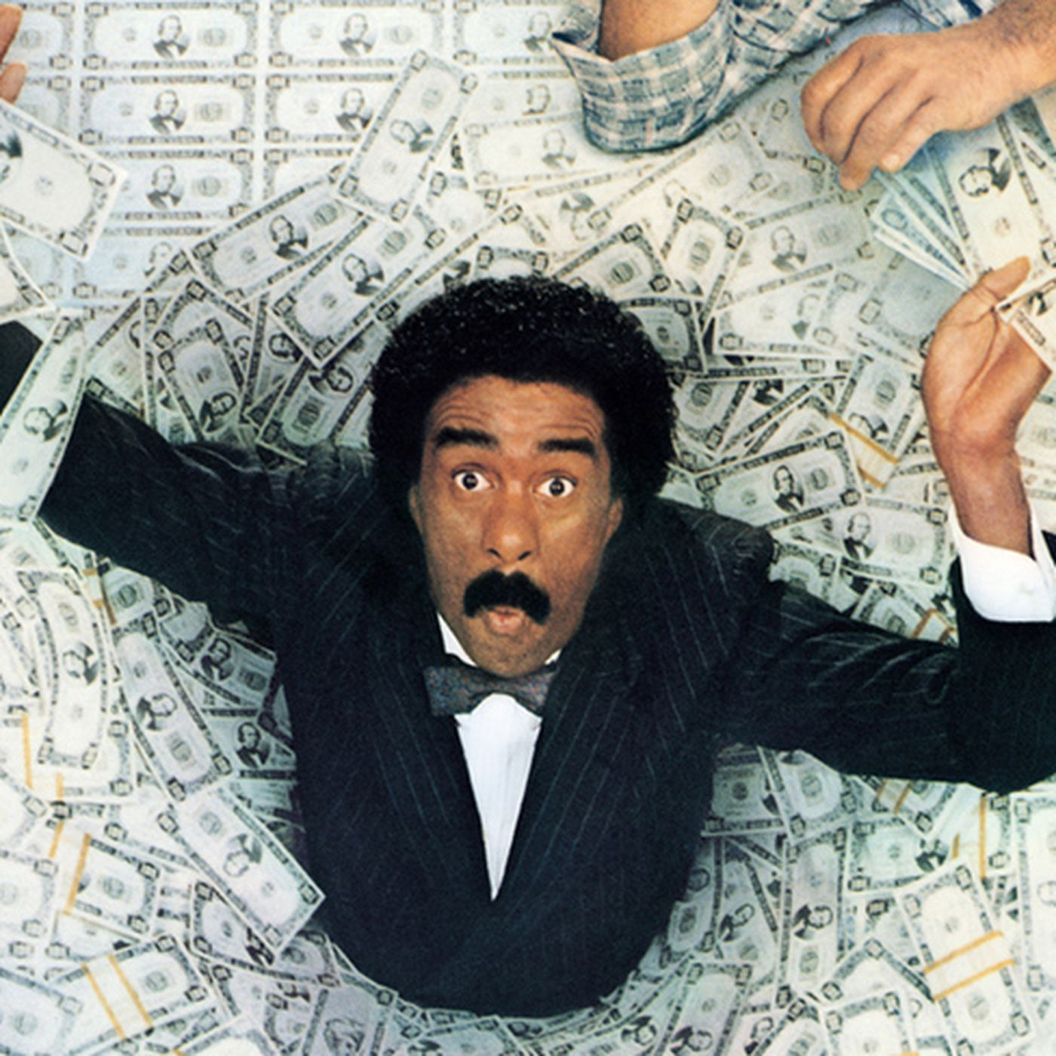
what IS success?
(net) profit
return on investment (ROI)

Slide 3
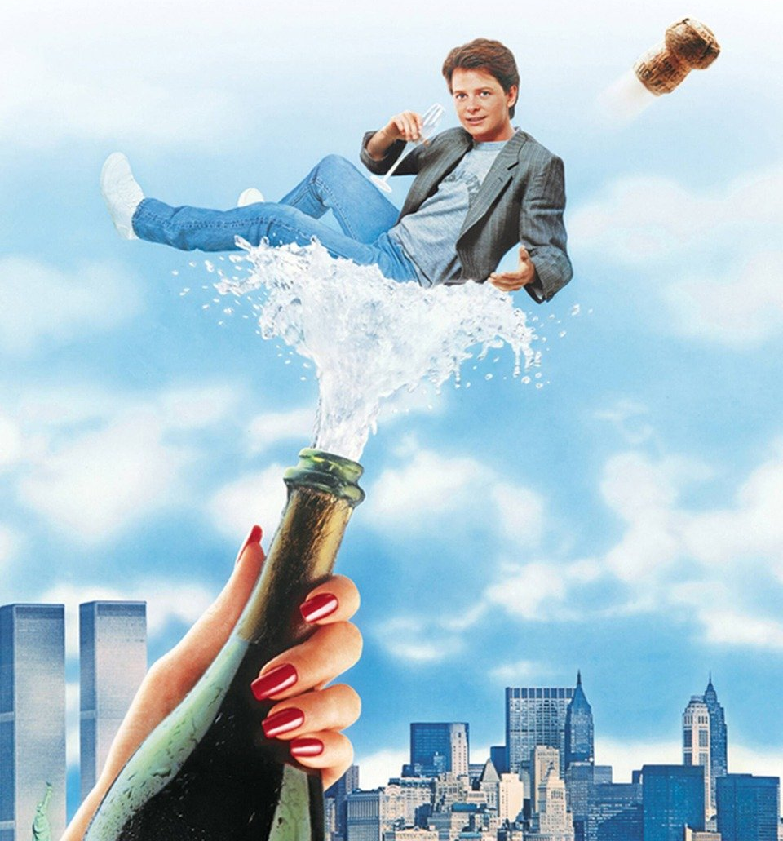
what CAUSES success?
runtime
genre
MPAA rating
profit history of director/cast

Slide 4
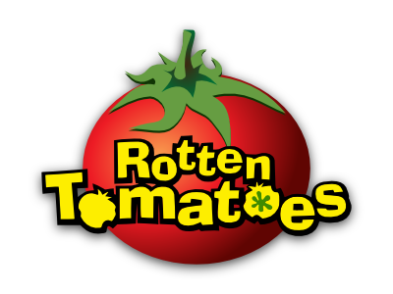


data resources

Slide 5
5,782 records
period: 1915-2020
budgets and grosses

Slide 6
17,712 records
period: 1914-2020
runtime, genre, MPAA rating, director

Slide 7
146,144 records
period: 2010-2020
runtime, genre, director, leads

Slide 8
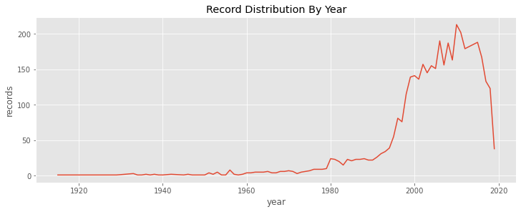
4,197 usable records

Slide 9
feature creation
(net) profit, ROI
adjustment for inflation
runtime intervals
distinct genres
profit history (of directors, of cast) *
* more on that soon

Slide 10
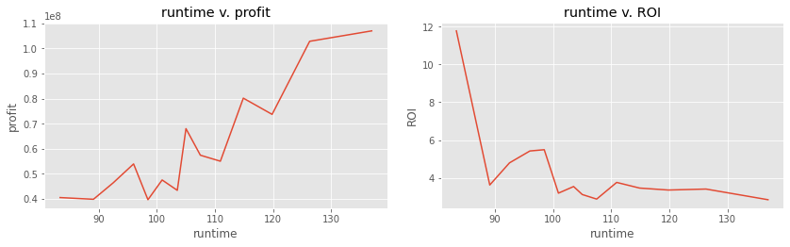
runtime

Slide 11
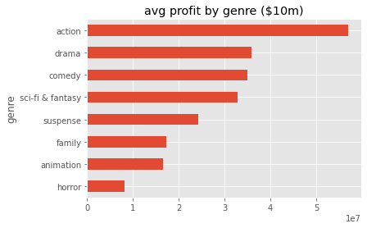
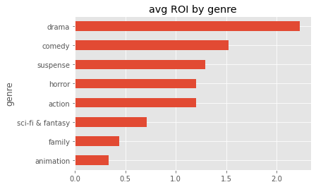
genre

Slide 12
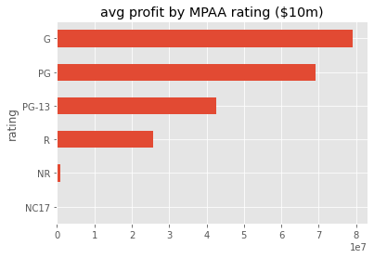
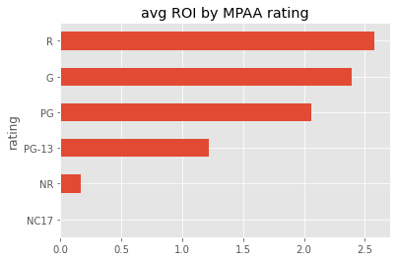
MPAA rating

Slide 13

“profit history” — an example
…
1984: Indiana Jones and the Temple of Doom
1985: The Color Purple
1987: Empire of the Sun
1989: Indiana Jones and the Last Crusade
1991: Hook
1993: JURASSIC PARK
avg. profit 1975-1992: $883 million
…
1984: Indiana Jones and the Temple of Doom
1985: The Color Purple
1987: Empire of the Sun
1989: Indiana Jones and the Last Crusade
1991: Hook
1993: JURASSIC PARK
1993: Schindler’s List
1997: The Lost World
1997: Amistad
1998: Saving Private Ryan
2001: A.I.
…
1993
dir. Steven Spielberg
profit: $1.75 billion

Slide 14
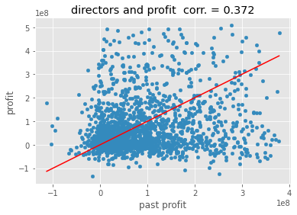
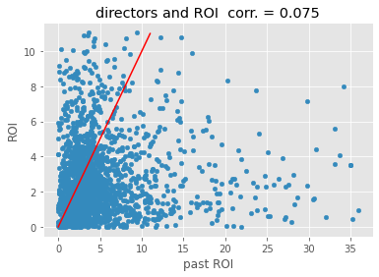
profit history:
directors

Slide 15
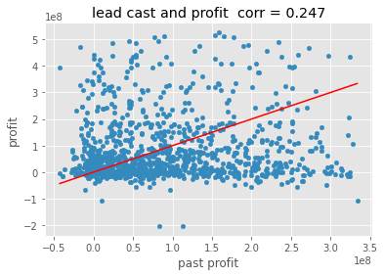
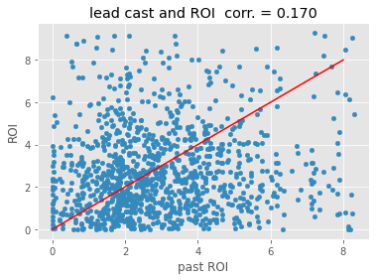
profit history:
lead cast

Slide 16
recommendations to maximize profit
115+ minutes
genre: action / adventure
G rating
assign a director with a strong record of past profits

Slide 17
recommendations to maximize ROI
at most 90 minutes
genre: drama
R rating
cast lead actors with strong records of past ROI

Slide 18
Thank you
Aaron Galbraith
www.linkedin.com/in/aarongalbraith

